Slide 1
Inventory Management System
Iteration 1
Team Members:
Ibukunoluwa “Abby” Aboderin
Mason Beckham
Raghad Safauldeen
Siddharth Vadgama

Slide 2
Project Plan
An inventory management website to help small business take inventory.
This software is intuitive, user-friendly and convenient.
How it Works: The user scans the barcode and it updates the stock items in the inventory and uses a third party software to handle payments to the business.
IM System will handle payments through an external party (like paypal)
No mobile app feature, only a webpage that can be accessible on a laptop or mobile phone.
Notes:
Abby
An inventory management website to help small business take inventory.

Slide 3
Features
Competitors:
Ordoro:Dropshipping Capabilities
Cin7: Designated Account Manager
Cin7: Payment Portal
Fishbowl: Starting price up to $4,000
Primary:
Open source and free to use
Different style of scanning compared to competitors
User friendly and Simple
Admin Login System
Notes:
Abby

Slide 4
Major Risks

Slide 5
Five Major Risks
Time management and communication
Risk Exposure: 70% * 8 Hours = 5.6 Hours
Lack of certain programming language knowledge and skills
Risk Exposure: 60% * 6 Hours = 3.6 Hours.
Our software is free, open source so all libraries used must be open source
Risk Exposure: 30% * 4 Hours = 1.2 Hours
Website might not work on certain browsers
Risk Exposure: 20% * 6 Hours = 1.2 Hours
Data limit on our server
Risk Exposure: 25% * 4 Hours = 1 Hour
Notes:
Raghad
How and when to deal with top risks

Slide 6
Design

Slide 7
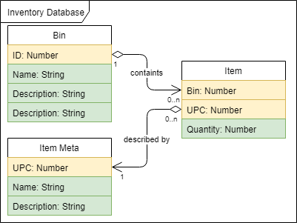
Class Diagram: Inventory Database
Notes:
Raghad

Slide 8
Use Case Diagram: Website
Notes:
Sid
/bin/update: Page includes all features related to updating bin information and current items
/bin: Lists all items currently located within a bin
/: Default landing page for the Inventory Management system, will redirect for login and provide interface for searching
/search: Based on UPC searched for it will display all item bin locations and their quantities
/login: Will provide login service, on successful login attempt will update session to allow access to all other feature

Slide 9
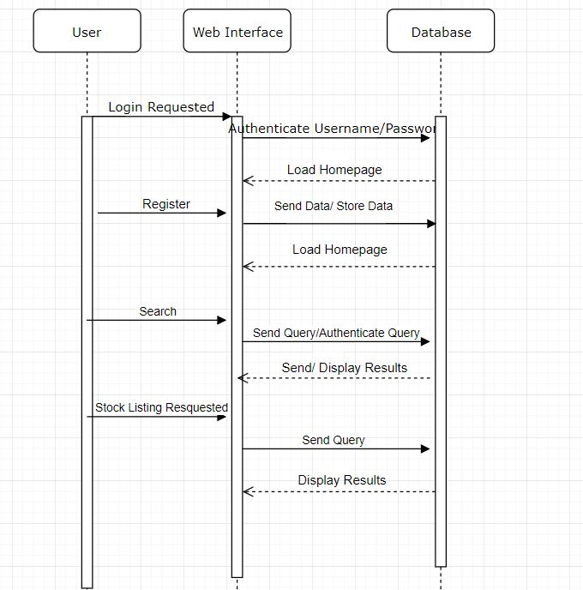
Sequence diagram:
API
Notes:
Sid

Slide 10
Specification

Slide 11
Specification
Testing
Multiple Node JS packages
Mocha, Supertest
Chai
Husky and Lint-Staged
Manual tests
Documentation
Generated by APIDOC.
Javadoc-Style is used
Documentation ==> HTML page
Compilation & Running
No compilation is required
‘npm start’ will start the application
‘npm run devstart’ will start the application in a developer mode
Notes:
Mason

Slide 12
Structure
The application code is structured into sub-directories
/bin/www contains the startup code for the server app.
/app.js contains the server application code
/db.js initializes the connection to the MongoDB instance
/public/{js,css} are where all static JS and CSS files are placed
/routes/ contains the primary working code for the app.
/test/ provides all relevant tests for the app.
/views/ is the location of all template files
Notes:
Mason

Slide 13
Code & Testing

Slide 14
Testing Example
const request = require('supertest') const app = require('../../app') const should = require('chai').should() describe('GET /', function () { it('responds with OK', function (done) { request(app) .get('/') .end(function (err, res) { if (err) done(err) res.status.should.equal(200) done() }) }) })
Notes:
Mason

Slide 15
Thank You
Questions?

